Slide 1
National Trade Corridors Fund Recapitalization
January 2022

Slide 2
Background:
National Trade Corridors Fund:
In 2017, $1.9B allocated over 11 years (2017/18 to 2027/28)
2021 budget doubled the original $1.9B to give $3.8B
plus additional $0.4B for Northern projects for a total of $4.2B
The ‘new’ $1.9B is also over 4 years ($475M annually) compared to the original which was over 11 years ($173M annually).
The 2021 budget almost tripled (2.75 times) the Feds annual investment over the next 4 years
Questions:
Is this new investment sufficient?
How much should be invested in Western Canada?
What are the

Slide 3
Obstacles to Exporting
Fraction of businesses reporting:
Efficiency, capacity or reliability of transportation infrastructures
as a difficult obstacle to exporting
Most business not having difficulty or, difficulty is decreasing
Exception is Agriculture, where all regions except Quebec are having increasing difficulty exporting

Slide 4
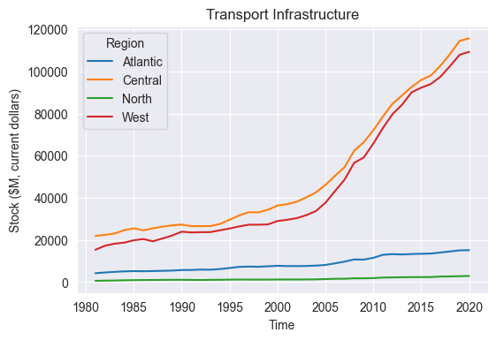
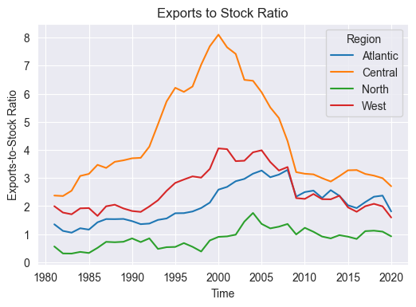
Background: Transport Infrastructure Stock
Transportation infrastructure stock has been significantly increasing in Central (ON + QC) and Western Canada
Since 2010, volume of trade in goods (export + imports) relative to transportation stock has flattened
Trade in services is excluded
Since 2010, volume of trade is roughly proportional to transport stock
Exports are a direct component of GDP
However, imports subtract from GDP

Slide 5
Port and Rail Volumes
Port | Exports (TEUs, 2019) | Western Hemisphere Ranking (2019)
Port of Vancouver (BC) | 1,121,973 | 7th
Montreal Port Authority (QC) | 704,111 | 12th
Halifax Port Authority (NS) | 235,223 | 20th
Prince Rupert Port Authority (BC) | 192,068 | 22nd
Rail Division | Tonnes in 2019
Eastern Division | 143,283,706 (37%)
Western Division | 242,903,433 (63%)
About 58% of goods shipped by boat left through Western Canada ports in 2019
https://www.aapa-ports.org/unifying/content.aspx?ItemNumber=21048
Almost 2/3rd of the total rail traffic carried (by tonnage) occurred in the Western Division (2019 data)
Any investment in transport infrastructure should reflect this difference in demand
To match volumes, about 60% of transport infrastructure investment could be made in Western Canada

Slide 6
Economic Contributions
Key Assumptions:
Increase in transport infrastructure stock results in corresponding increase in exports (using 2010 to 2019 average)
Increase in exports is a component of GDP
Increase in GDP results in jobs, wages
Given current levels of investment in transport infrastructure, every additional $1M invested supports:
151 jobs across the country, and $7.5M in wages and salaries
$17M in export-related GDP activity

